Slide 1
Software Requirements Evolution*
D. A. Tamburri, Ph.D.
*Slides courtesy of Prof. Dr. Alex Serebrenik@TUe

Slide 2



Slide 3

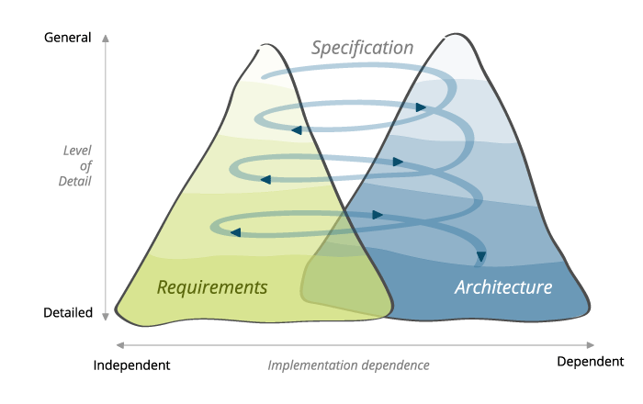

Slide 4
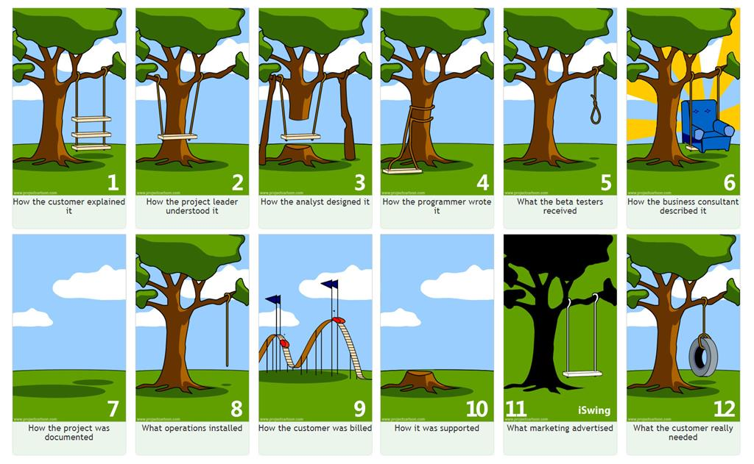

Slide 5
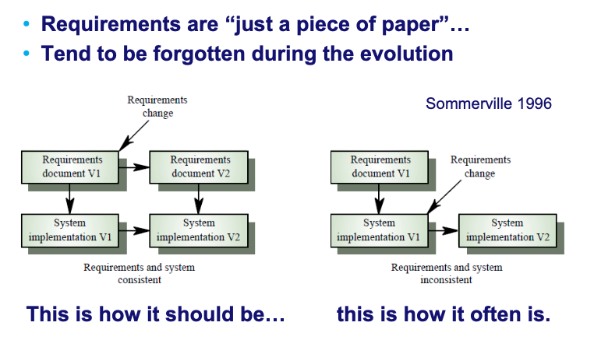
Requirements Evolution

Slide 6
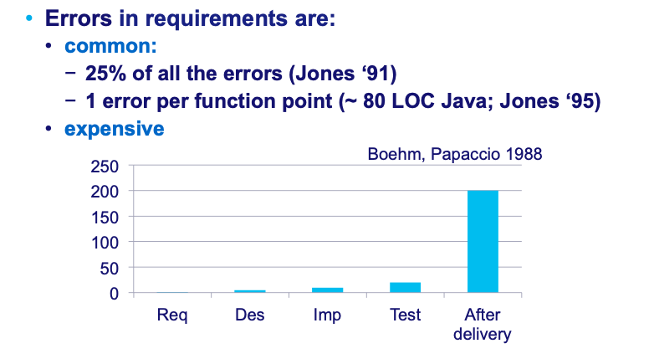
Why requirements?

Slide 7
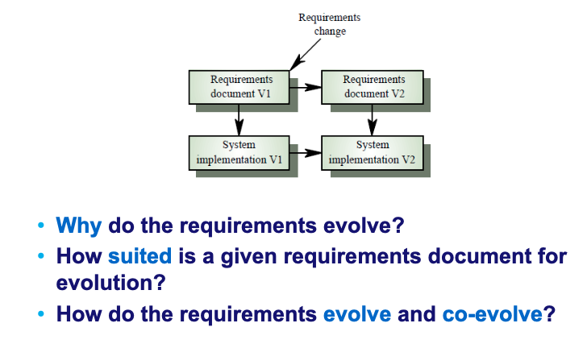

Slide 8
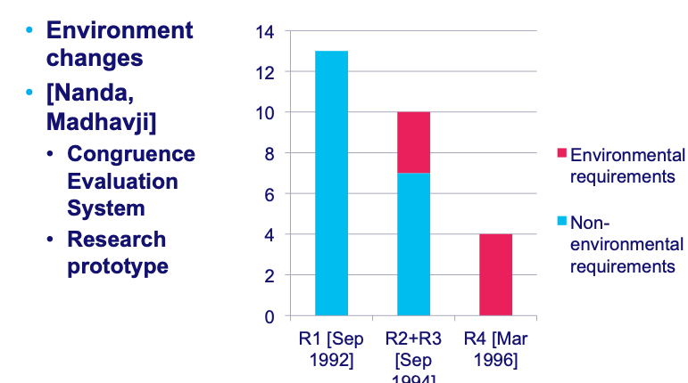
Why do the requirements evolve?

Slide 9
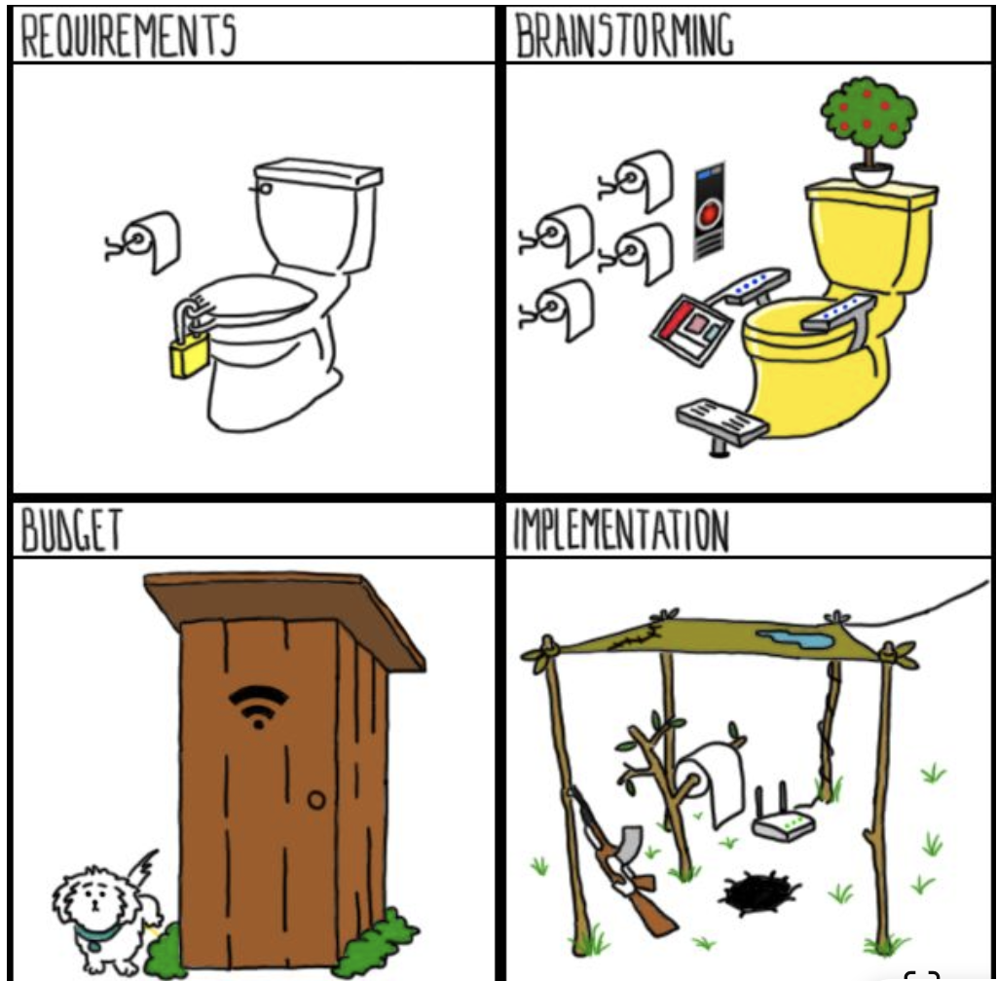

Slide 10
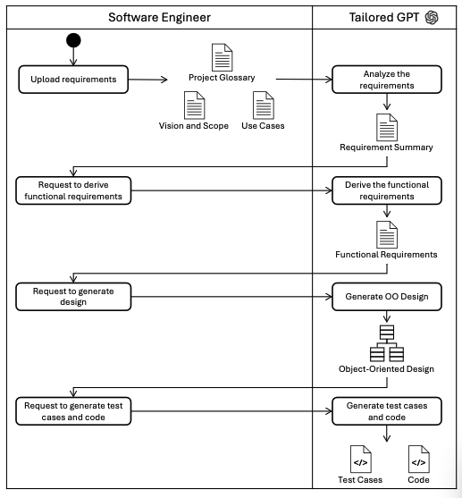
arXiv:2406.10101 [cs.SE) https://doi.org/10.48550/arXiv.2406.10101

Slide 11
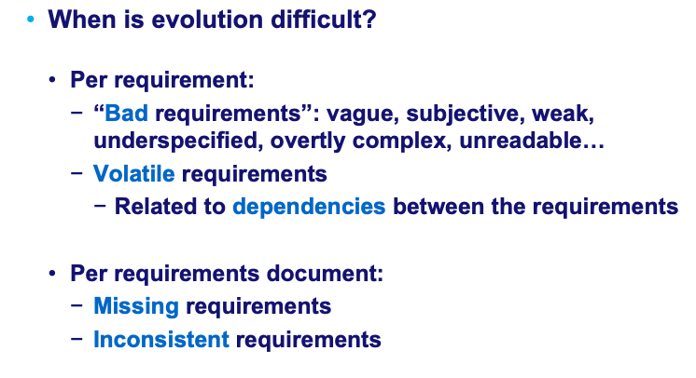
Suitability for evolution

Slide 12
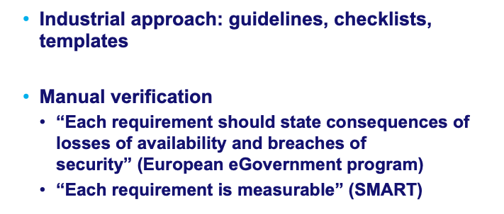
Spotting bad requirements: Evolution & Quality check lists

Slide 13
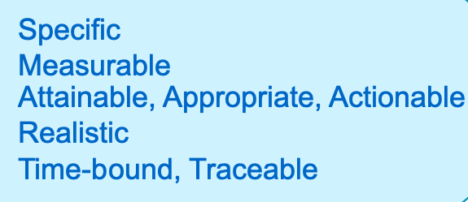
The SMART approach

Slide 14
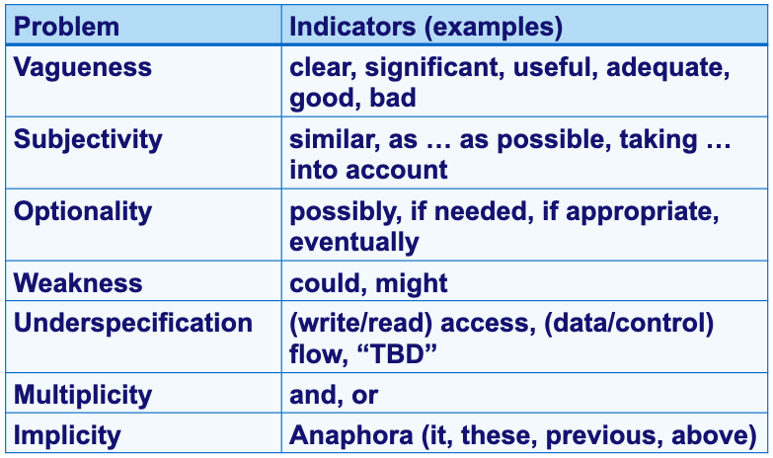
Bad requirements: More automation?*
* Fabbrini, Fusani, Gnesi, Lami, 2001.

Slide 15
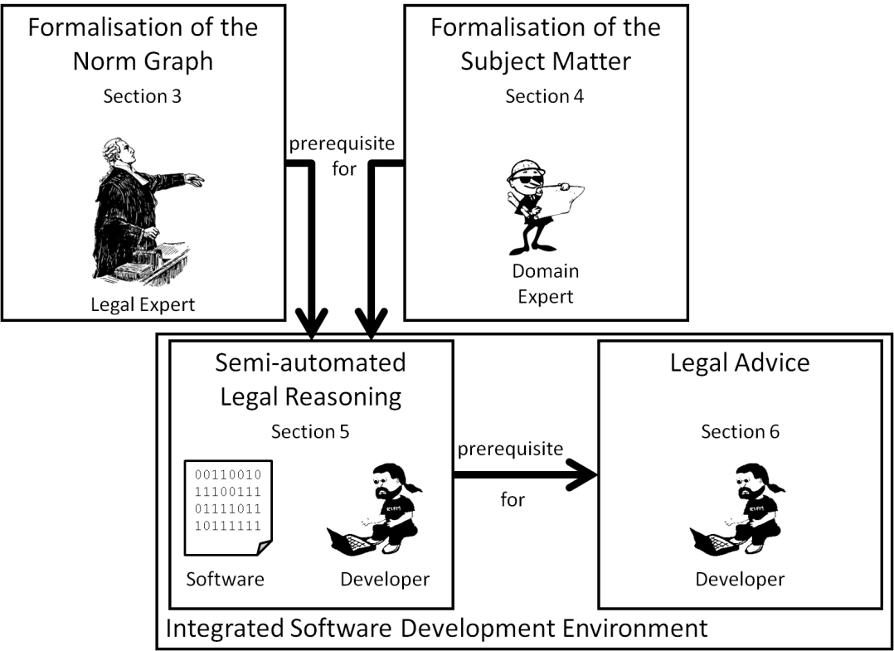

Slide 16
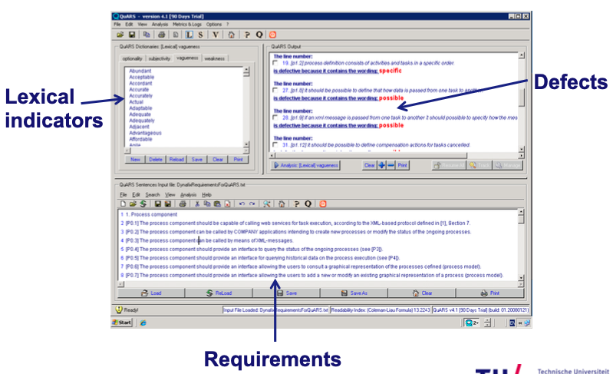

Slide 17
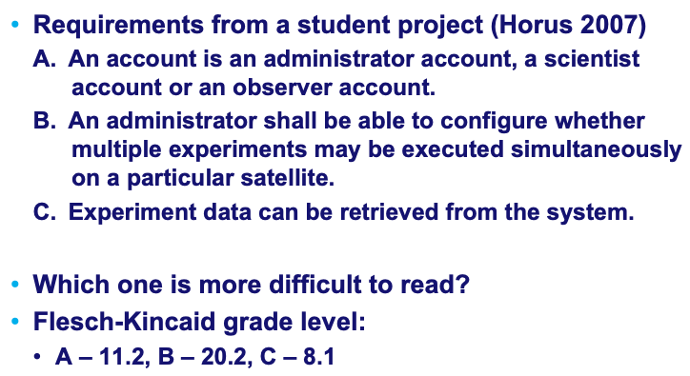
Readability measurement

Slide 18
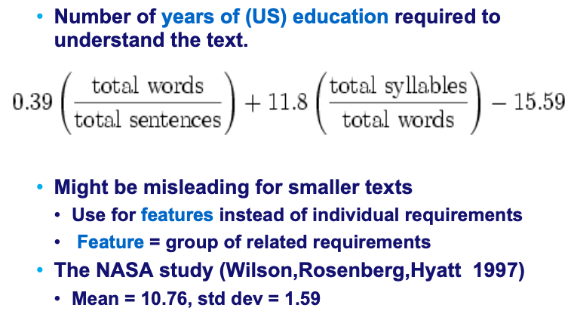
Flesch-Kincaid grade level

Slide 19
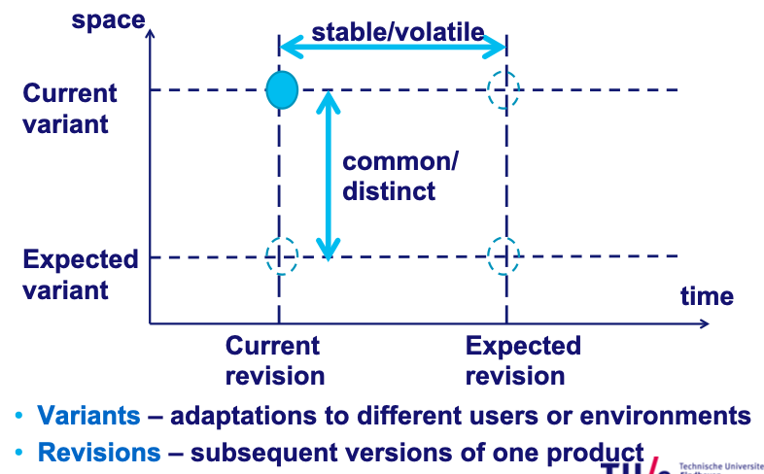
Second problem: Volatile requirements

Slide 20
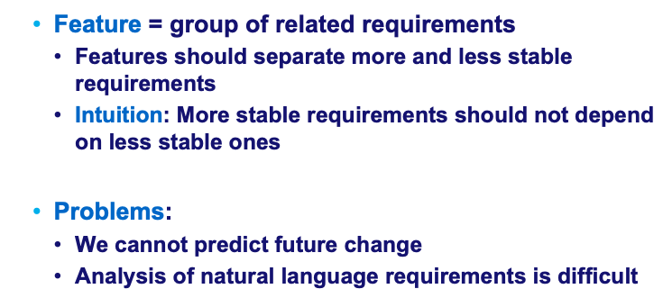
How can we identify volatile requirements?

Slide 21
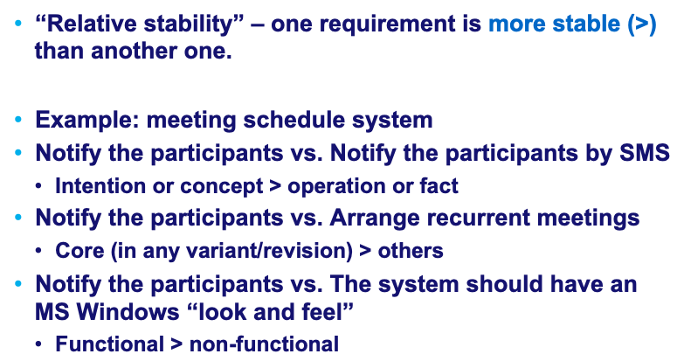
Relative stability
NB: Conflicts and choices among different options are
usually quite volatile!

Slide 22
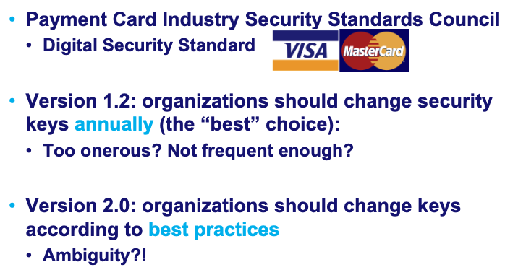
Conflicts and choices among different options are usually quite volatile: Example

Slide 23
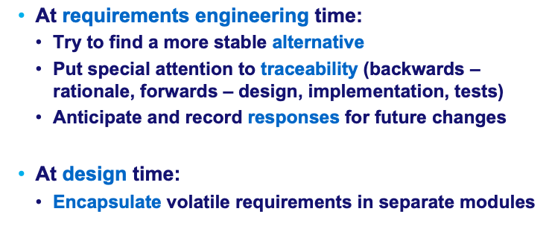
How can we address volatility?

Slide 24
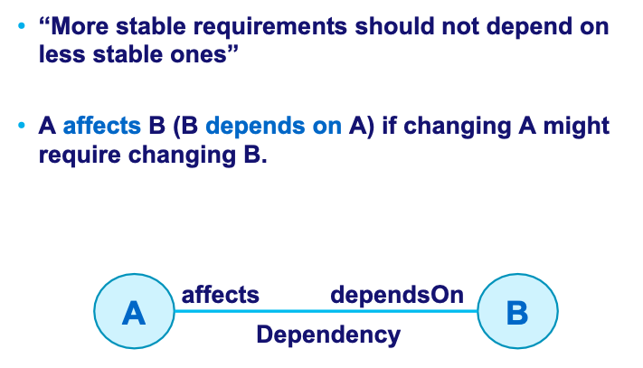
Volatility and dependencies

Slide 25
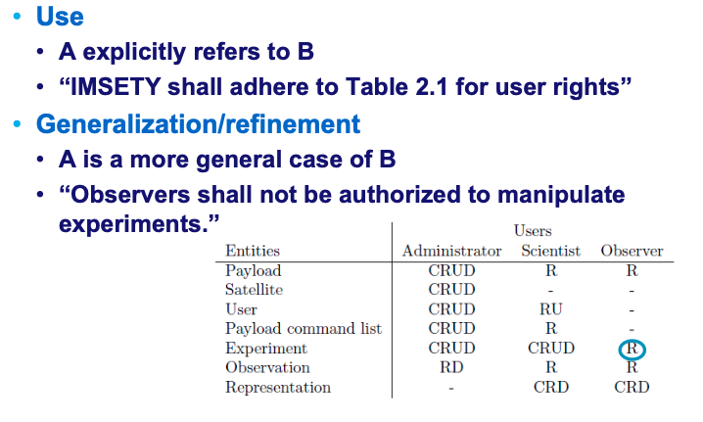
Types of dependencies (examples)

Slide 26
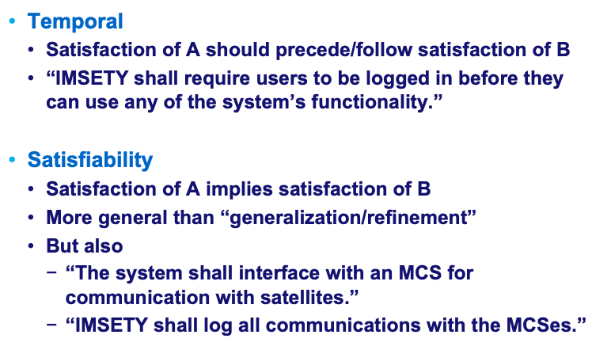
Types of dependencies (examples, continued)

Slide 27
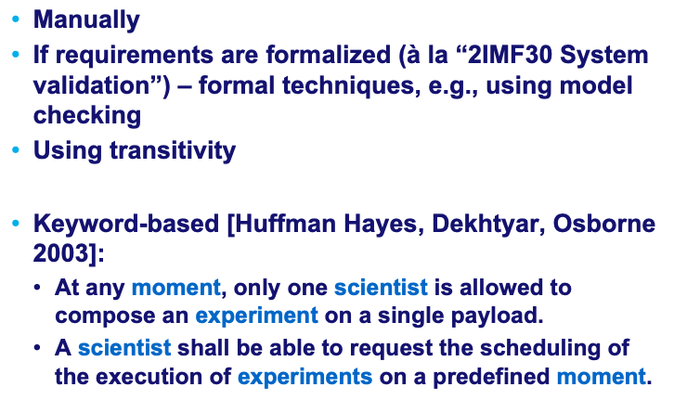
How can we derive dependency relations?

Slide 28
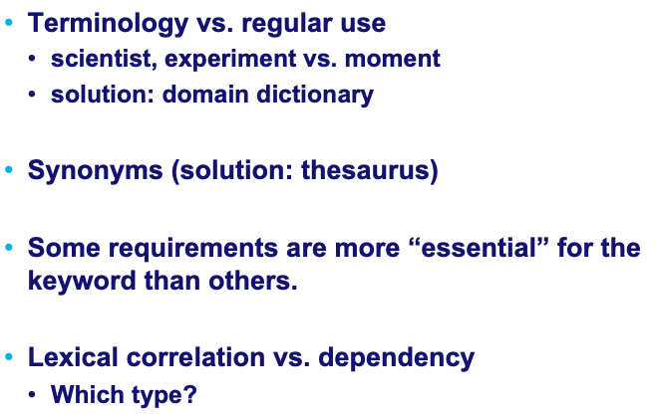
Problems (and solutions) with keyword-based

Slide 29
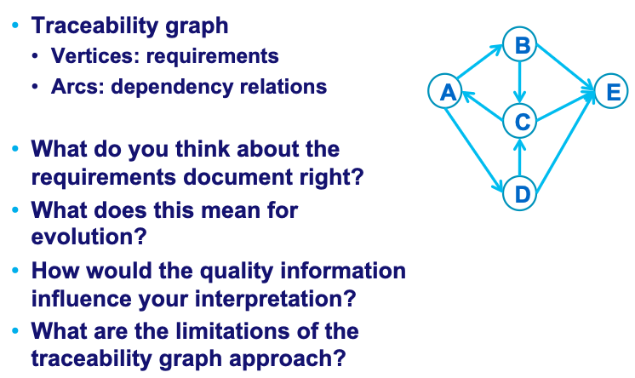
Dependency analysis

Slide 30
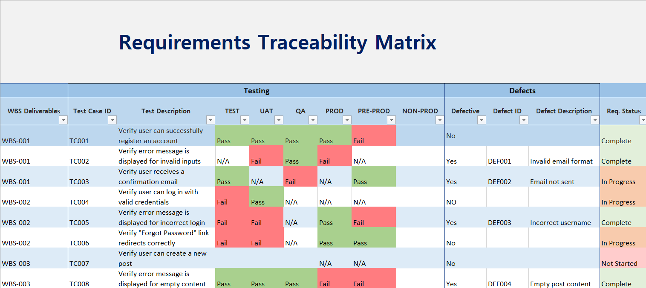

Slide 31
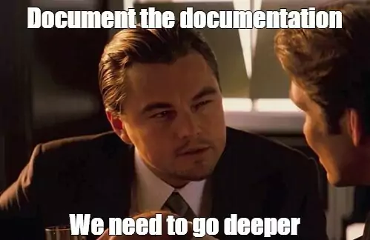

Slide 32
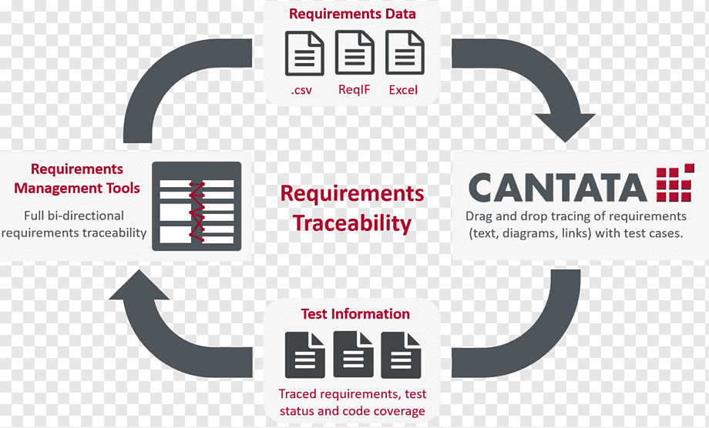

Slide 33
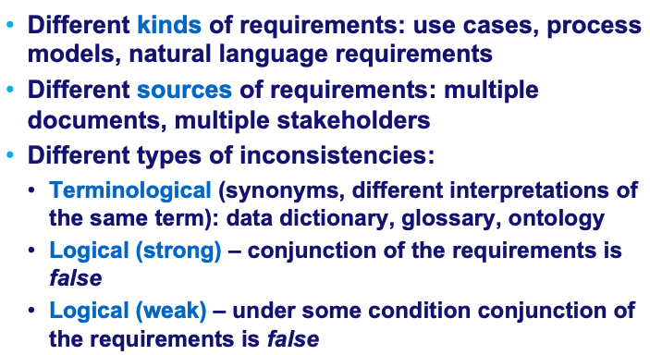
Inconsistent requirements

Slide 34
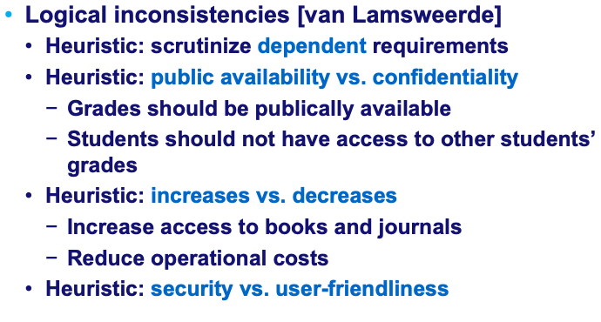
Logical inconsistencies: Heuristics

Slide 35
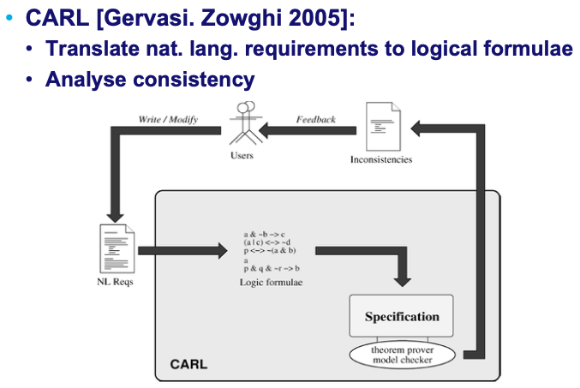
Inconsistent requirements: Linguistics+Logics

Slide 36
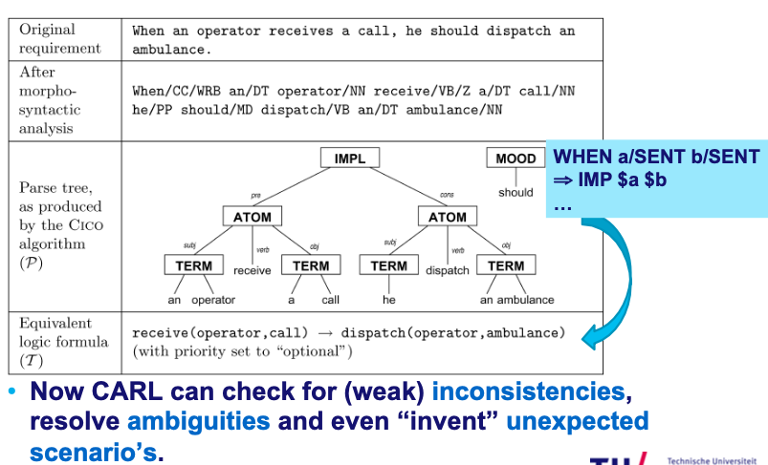
CARL: From text to formula

Slide 37
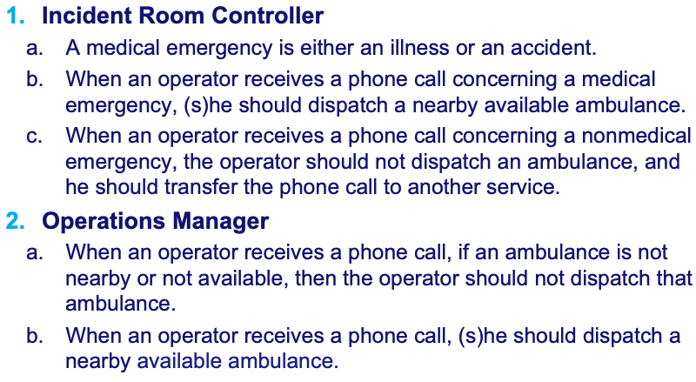
CARL: Detect inconsistency

Slide 38
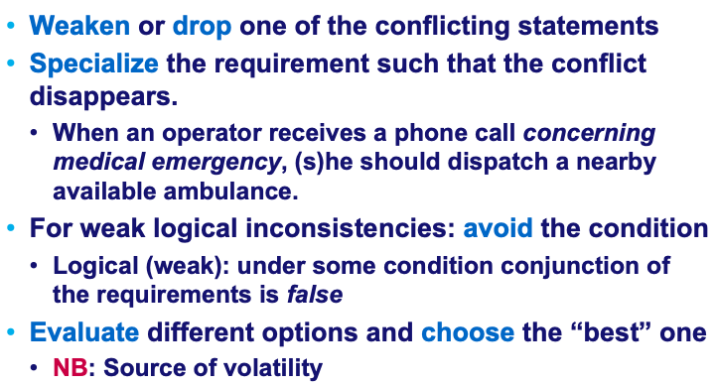
How can we address inconsistency?

Slide 39
Recap
Requirements evolution can be hindered by
“Bad requirements”: vague, subjective, weak, underspecified, overtly complex, unreadable…
Volatile requirements
  Related to dependencies between the requirements
Missing requirements
Inconsistent requirements

Slide 40
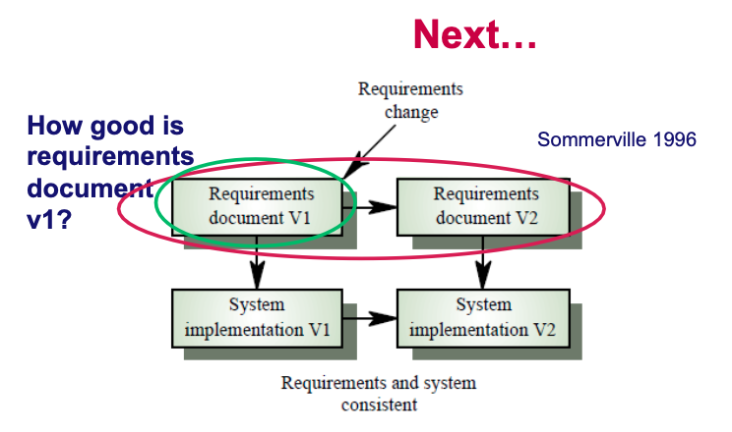

Slide 41
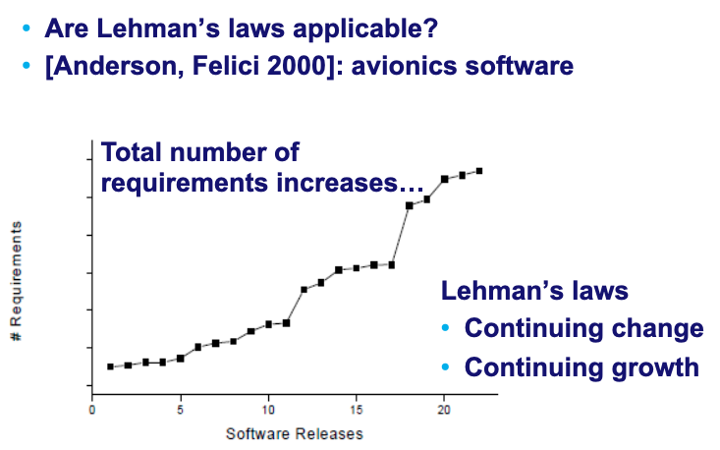
How do the requirements evolve?

Slide 42
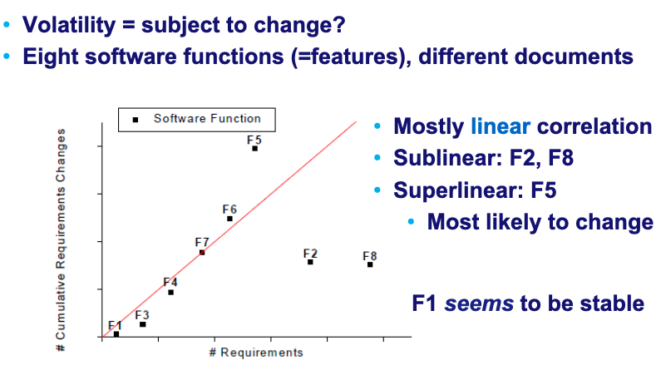
Evolution and volatility

Slide 43
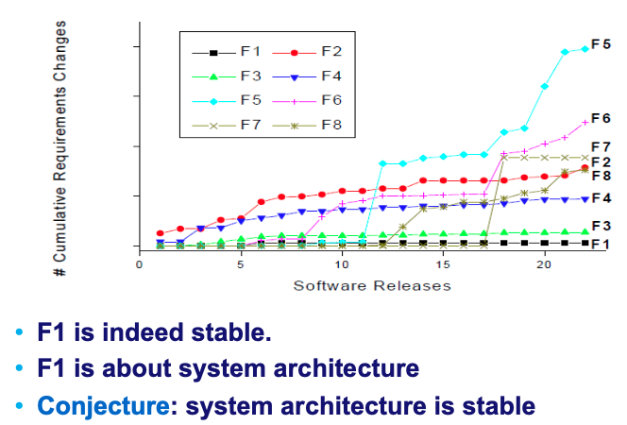
Closer look at the 8 functions (1)

Slide 44
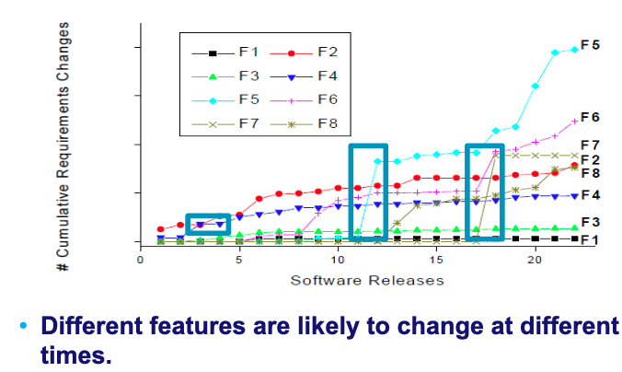
Closer look at the 8 functions (2)

Slide 45
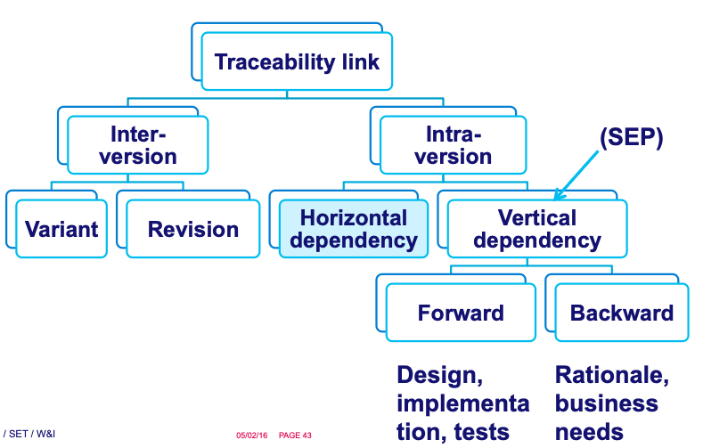
Co-evolution: Traceability links!

Slide 46
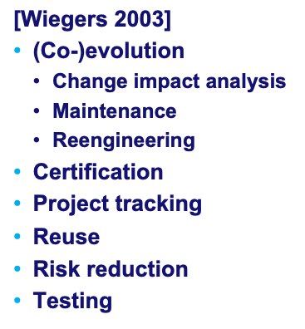
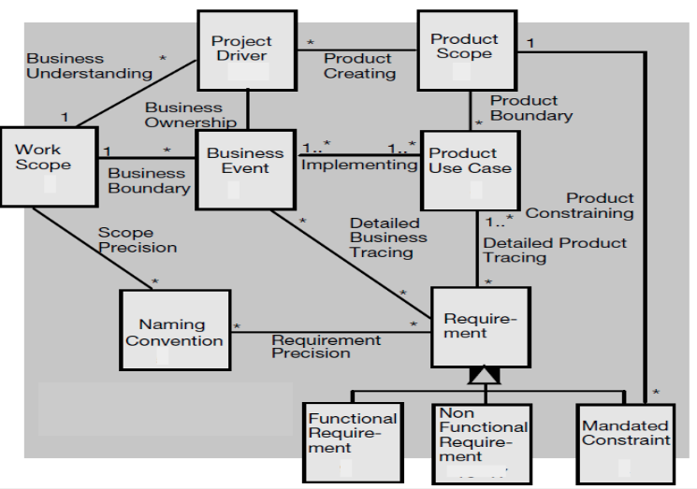
Why traceability?
Other Dependencies?

Slide 47
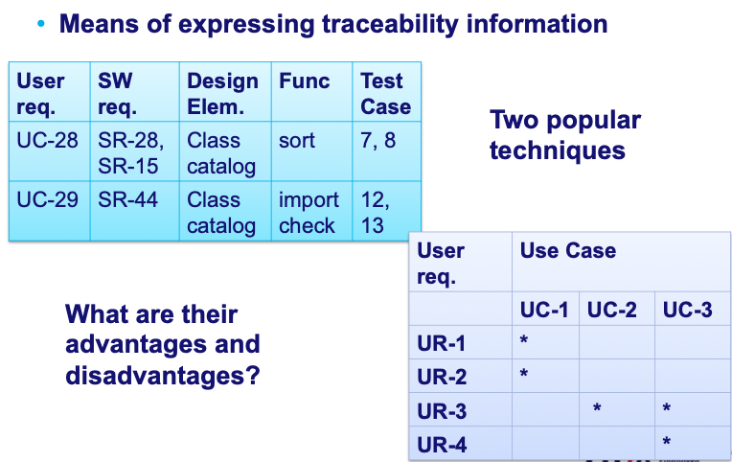
Traceability matrix

Slide 48
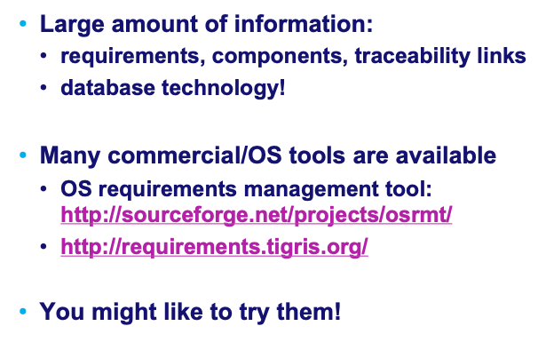
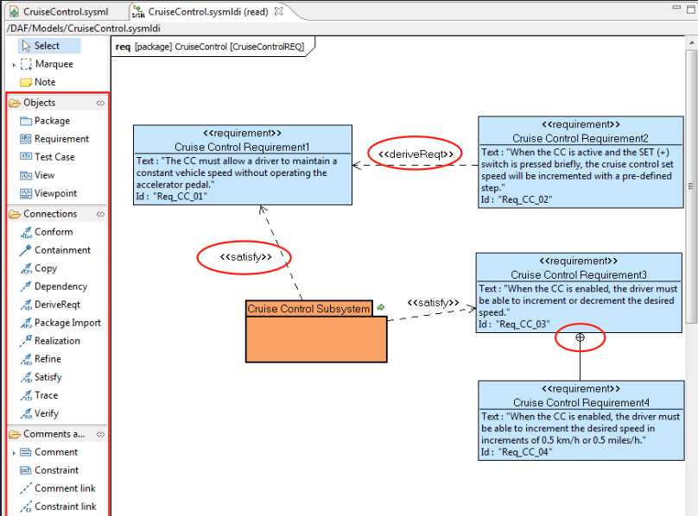
Does it scale?

Slide 49
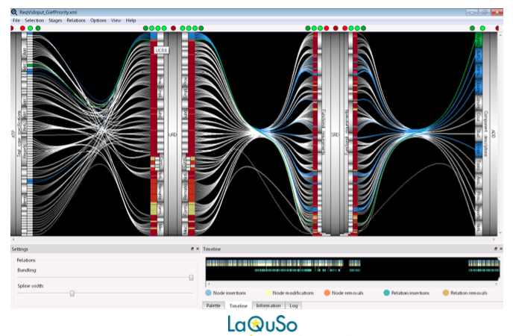
TraceVis!*
*M.Sc. thesis of Wiljan van Ravensteijn 2011

Slide 50
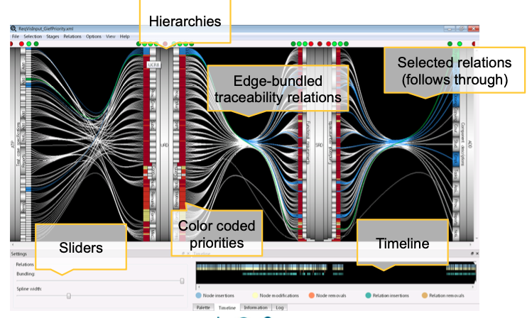

Slide 51
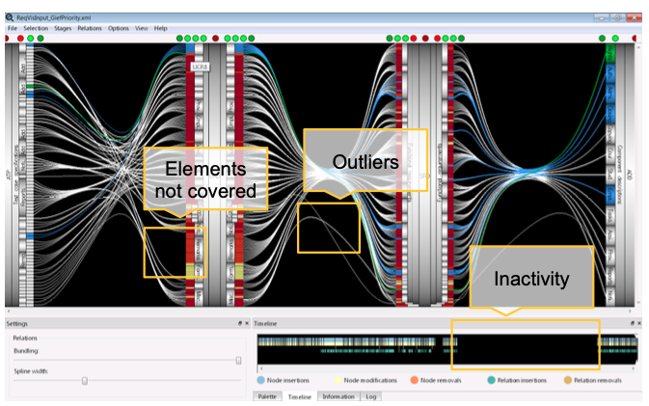

Slide 52

In reality, nowadays…

Slide 53








Independent Agile Consulting
Founder at Nexxle
Chief Agilist
Enterprise Transformation
Built Agile Delivery team
800 Team Transformation
Acquired by
Founder, CEO, CTO
Past President

Slide 54
User Stories
Components of a User Story
Who: iOS user
What: redundant copy of data on device
Why: in case of accidental changes
iOS user wants redundant copy of data on device in case of accidental changes
Characteristics of User Stories
Can be implemented in any order
Does not specify how to implement it
Customer/market focused
Small
Something that could be done as a “patch” in a week or less

Slide 55
Bill Wake’s “INVEST” Guidelines
Independent
  To the extent possible, stories can be implemented in any order
Negotiable
  How to accomplish the goal is left open, no suggested implementation
Valuable to the user
  Something the user can actually use, not just a technical task
Estimable
  No research required, well understood
Small
  Can be taken from concept to ready for release within a couple of weeks and preferably within a couple of days
Testable
  It is possible to measure something specific to verify that the story is done

Slide 56
Valuable
Movie-goer wants to add e-tickets to shopping cart to skip line
Not valuable
V3
Movie-goer wants to buy e-tickets via shopping cart to skip line
Valuable
V3

Slide 57
Product > Epics > User Stories
Product: BYOD data backup for large businesses to protect IP
Full backup from device to datacenter
Reporting
User stories are the smallest unit of value
EPIC
EPIC
Android user wants to save/restore notes data for simple backup
Admin wants automated daily reports on storage usage to help spot trends
Secure api to backed up data to support 3pty services (eg anti-virus)
EPIC
EPIC
Quick encrypted backup to connected storage device
iOS user wants redundant copy of data on device in case of accidental changes
EPIC
EPIC
Incremental backups
Backup for older devices

Slide 58
Products to Epics to Stories
Products
Epics
User Stories
(start to prod in < 2 weeks)

Slide 59
Negotiable
Regulator wants name and address entered to validate a customer’s identity
Not negotiable
NT
Regulator wants information entered to validate a customer’s identity
Negotiable
NT

Slide 60
Testable
Shopper wants high availability to be able to shop at any time
Not testable
NT
Shopper wants the system to be down for no more than 5 seconds per week to be able to shop at any time
Testable
NT

Slide 61

Conclusions

Slide 62

The LLM bit…
What can my pet LLM do for me in this context*?
* https://arxiv.org/html/2405.01564v1

Slide 63

Questions?

Slide 64

More about requirements evolution?

Slide 65


